Slide 1
Digital Portfolio
STUDENT NAME : Elango.S
REGISTER NO AND NMID : 222402513/asunm161222402513
DEPARTMENT : BSc.Computer science
COLLEGE: COLLEGE/ UNIVERSITY : Prince Shri Venkateswara Arts
And Science College/Madras University

Slide 2
PROJECT TITLE :
Digital Portfolio

Slide 3


AGENDA
Problem Statement
Project Overview
End Users
Tools and Technologies
Portfolio design and Layout
Features and Functionality
Results and Screenshots
Conclusion
Github Link
3/21/2024 Annual Review

Slide 4

PROBLEM STATEMENT
Traditional paper portfolios fail to effectively showcase skills and achievements.
Students and professionals lack an engaging way to present their work.
Evaluators face challenges in assessing competencies without clear organization.
A digital portfolio offers an interactive and accessible solution.

Slide 5

PROJECT OVERVIEW
A digital portfolio helps showcase skills, achievements, and projects in a structured way. Traditional resumes are limited, making it harder to highlight full potential. A digital portfolio allows easy updates, sharing, and better visibility, supporting career growth, personal branding, and opportunities in the digital era.

Slide 6

WHO ARE THE END USERS?
Potential Employers/Recruiters – to evaluate skills, projects, and experience.
Clients/Collaborators – to explore work samples before partnerships.
Peers/Community – for networking, learning, and inspiration.

Slide 7

TOOLS AND TECHNIQUES
Vs code - Code Editor
HTML – Structure purpose
CSS – Styling purpose
Github – Hosting Platform

Slide 8
POTFOLIO DESIGN AND LAYOUT
Include selection :
Home
About
Skills
Contact
‹#›

Slide 9
FEATURES AND FUNCTIONALITY
Features:
The characteristics or attributes of a product/system.
Describes what it has.
Example: In a mobile phone – camera, fingerprint lock, Bluetooth, and storage capacity are features.
Functionality:
The purpose and operations that the product/system can perform.
Describes what it can do.
Example: In a mobile phone – taking photos, making calls, sending messages, and browsing the internet are functionalities.

Slide 10
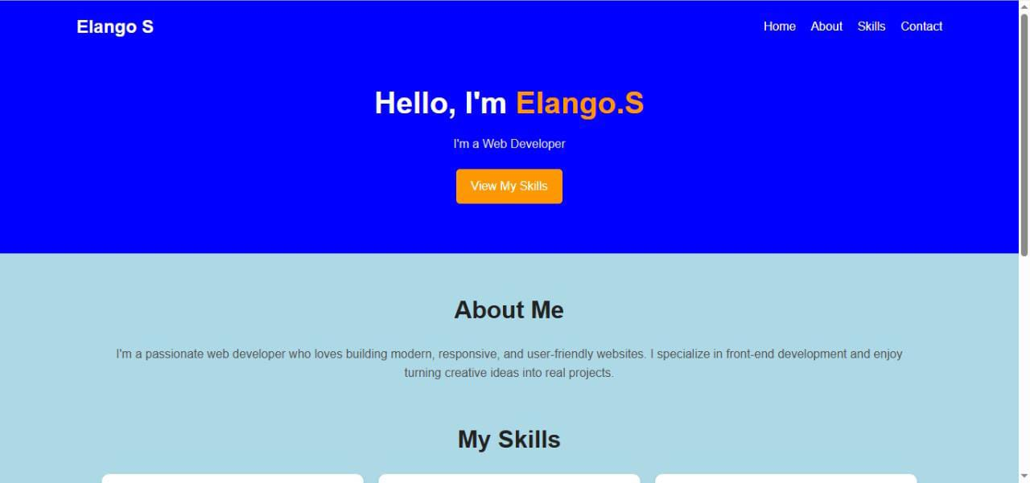

RESULTS AND SCREENSHOTS
3/21/2024 Annual Review
‹#›

Slide 11
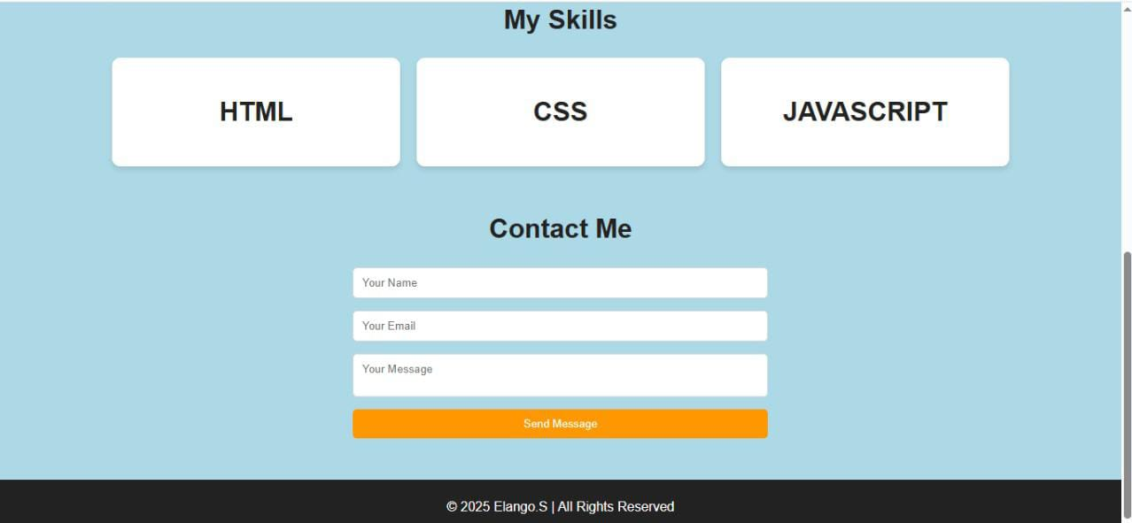

Slide 12
CONCLUSION
This portfolio highlights my skills, knowledge, and achievements, reflecting my growth and learning journey. It demonstrates my ability to apply concepts practically, showcase creativity, and adapt to challenges. Overall, it serves as a record of my progress and a foundation for future improvement and opportunities.
‹#›

